Slide 1
Effective Use of SIMS
Jane McFall
Education Product Specialist

Slide 2
Objectives
Making the most of SIMS in your school
Achieving efficiencies in the school office

Slide 3
The School Office
Sea of calm or scene of chaos?
Who does what, when and how?
Manual processes v automated processes?
Statutory legislation
Notes:
Take a minute to ‘picture’ your school’s office/admin area(s)
Does everyone know what they should be doing, when, deadlines?
Could processes be automated? Is there a reluctance to change? i.e. we’ve always done this! Duplication of effort
Is everyone aware of their statutory responsibilities –GDPR, Health & Safety

Slide 4
Use of SIMS in your School
Admin
Teacher
Senior Leaders
Student/Pupil data
Full Access
Just Basic Details
No Access
Full Access
Full Access
Just Basic Details
No Access
Just Basic Details
No Access
Notes:
just used as an administration tool to enable production of statutory returns
never access, prefer to use other systems, manual processes, always asking the office for information
never access, prefer to use other systems, get the admin office to produce analysis reports, easily persuaded that another system will be better

Slide 5
Technology Systems
Time wasters?
Time savers?
Duplication?
Resilience?
Did you know that 10% improvement in your use of time could free up 6mins every hour (45 mins per day, 3.75 hours per week – ½ day)
Notes:
How effectively do we use our working day?
could we use our working time more efficiently, are you spending time on things you shouldn’t or that others could?
Did you know that 10% improvement in your use of time could free up 6mins every hour (45 mins per day, 3.75 hours per week – ½ day)
Sign up for newsletters/bulletins – specific to your requirements i.e. Scomis Bulletin
User Groups

Slide 6

Pupil Record
Pupil Record
Interventions
Conduct
SEND
Personnel
Assessment
Attendance
Name,
Contact Details
Family/Home
Additional Information
Address
Medical
Cultural
Welfare
Factors
FSM
CIC
SEN
PPI
Dietary
School History
Consent
Young Carer
Transient
Notes:
The core record in SIMS is the Pupil Record. All schools using SIMS will have their complete pupil record stored within it. SIMS allows you to record all the contact details, the Pastoral Factors and other information as well, such as Dietary needs or School History. This record is then the base record for all areas of SIMS to connect to. This means that you can analyse the child against their peers, with children in a similar circumstance or ensure that they get additional help. SIMS allows you to identify the child, assess their needs and record the implemented solution with results.

Slide 7
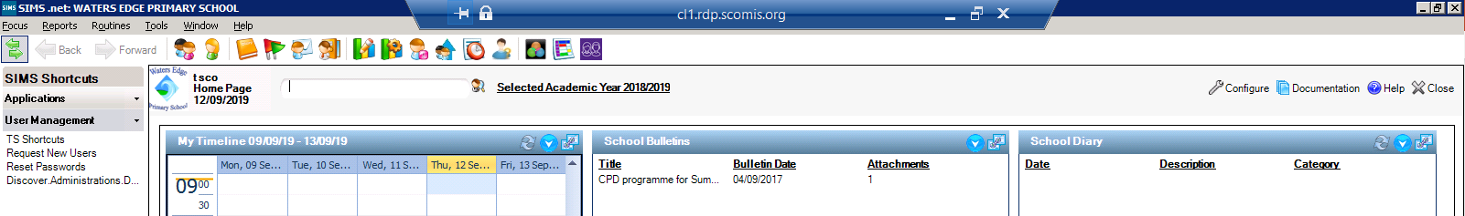
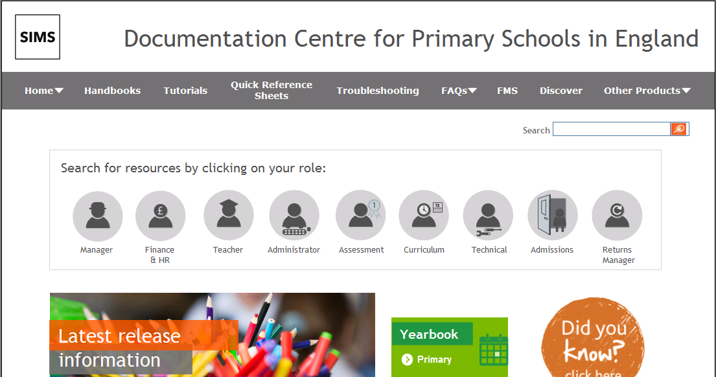
Help!!!! SIMS Documentation
The Secondary Yearbook
Notes:
Access to:
Handbooks, tutorials, Quick Reference Sheets, Primary and Secondary Yearbooks

Slide 8
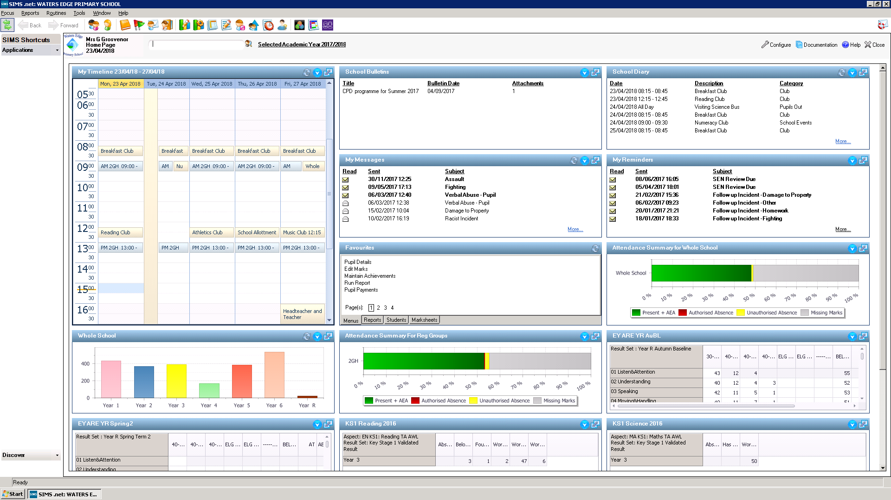
The SIMS Homepage
Notes:
The SIMS Homepage when configured can provide the user with a lot of information

Slide 9
Configuring the homepage
Puts data at your fingertips!
For now we are going to add ‘attendance’ and configure it for different groups
We do have the QRS sheet for you as well

Slide 10
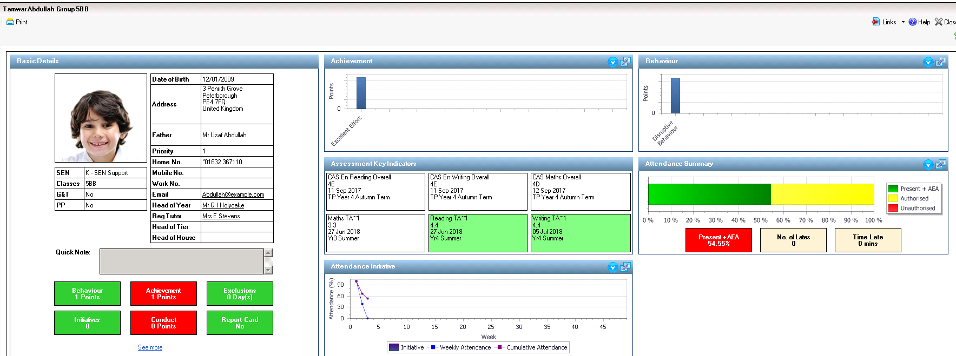
Student Teacher View
Notes:
This can be set as the default screen for teachers and gives a clear overview of the information entered for that student. You can print this and give a copy to parents, or simply use this as your discussion point when meeting them.

Slide 11
Pupil Teacher View/Student Teacher View
Configuring the Pupil Teacher View
  Tools>Setups> Pupil Teacher View

Slide 12

The quick tool bar
Try typing a surname into the box
OR
#B <Enter>
OR
Help <Enter>

Slide 13
Adding Students
Focus > Pupil> Pupil Details or click and then click the New button
Type in the students Surname, Forename, Gender and DOB. Click
Enter all the compulsory fields (shaded in red)
To add an address type in the post code or the street name and click
Add contact by clicking New next to the contacts panel. Choose an existing contact or create a new one
To add another parent you should use the Clone button
To copy contacts from another child you MUST use the Copy Button
Add any medical information and Save
Notes:
See Quick Reference Sheet

Slide 14
Importing and Exporting CTFs
Routines > Data Out >CTF > Export CTF

Slide 15
Export CTF

Slide 16
Import CTF

Slide 17
DfE
Worth checking the S2S website termly for new arrivals data or students with missing data

Slide 18
Making a student leave
Open their record and click on School History
Enter the date of leaving and the reason
Add the destination after leaving if known and Save

Slide 19
Making a group of students leave
Routines> Students> Leavers
Use the Class or Year Group fields to narrow down. Use the drop down on select to Select All
Or use the Ctrl and Shift Keys and se the drop down on select to Selected
You can now enter the date of leaving and a reason for leaving. Enter a destination and select the pupils going to that destination using Ctrl and Shift. Then click the
You can then change destination and select another group of pupils. Repeat as needed
Click to add the information to the records – this may take some time

Slide 20
Readmit a pupil
Focus > Pupil > Pupil Details
Click the Type in the Surname and Forename. Click
The pupil should be matched with their previous record
Select the record and click . You will be asked if you want to re-admit. Click YES.
Enter the information into the required field and then Save

Slide 21
Pupils –User Defined Fields and Lookups
Tools> Setups> User Defined Fields https://faq.scomis.org/kb9359/
Tools> Lookups> Maintain

Slide 22
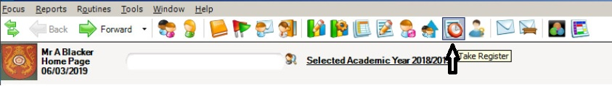
Registers
https://faq.scomis.org/kb23407/
Office staff can set up missing register notifications https://faq.scomis.org/kb23337/
First day of absence report Reports> Attendance> Selected Pupil Reports>First day of absence
Office staff can add lates and illness or even messages
Meal list report Reports> Attendance> Selected Pupil Reports> Meals List Report

Slide 23
Systems Manager – a gatekeeper
Always have two members of staff – just in case
Adding a new user and giving them Remote SIMS access https://faq.scomis.org/kb20691/
Don’t give everybody everything
See the Sims permissions spreadsheet – towards the bottom of the SIMS documentation page
Give permissions based on roll within school
Some permissions are given when you set up your pastoral structure
Report available to ‘check Users and Permissions’

Slide 24
Systems Manager
Administration Assistant
Admissions Officer
Assessment Coordinator
Assessment Operator
Attendance Manager
Attendance Operator
Capita Mobile User
Class Teacher
Curricular Manager
Cover Manager
Data Protection Officer
Exams Officer
Exams Operator
Partnership Server Agent
Partnership Server Manager
Partnership Server User
Pastoral Manager
Profiles Coordinator
Profiles Operator
Registrations Tutor
Returns Manager
Returns Operator
School Administrator
SEN Coordinator
Senior Management Team
System Manager
Timetabler
LGStudent
LGParent
LGTeacher
Application Links User
LA User
Teachers Desktop user
Teaching Assistant
Safeguarding Lead
Supply Teacher
Personnel Officer
Personnel Assistant
Personnel Events Officer
SP Manager
SP Line Manager
SP Appraiser
SP Staff
SP Administrator
Fees Manager
Fees Clerk
Receipts Clerk
Bursar
SLG Alerts Manager
External Auditor

Slide 25
Typical permissions
Class Teachers should have
Class Teacher
Registration Tutor
Subject coordinator
Curricular Manager
Also needs to be in Course Manager as a supervisor
SMT/SLT
Senior Management Team
KS coordinator
Curricular Manager
SENDCo
SEN Coordinator
Assessment lead
Assessment Coordinator

Slide 26
Systems Manager
Cull!
  When people leave or you stop using packages that link to SIMS remove their access
  Leaver’s process?

Slide 27
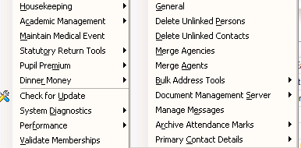
Housekeeping
Tools>Housekeeping

Slide 28
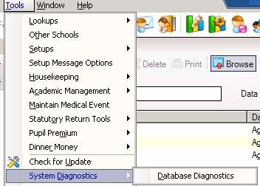
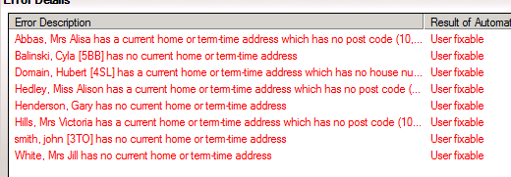
Other Housekeeping Continued
Tools> System Diagnostics> Data Diagnostics – DO NOT RUN NOW
Will automatically fix what it can but then give you a list of user fixable problems – look out for the ones highlighted in red

Slide 29
Adding a medical practice
Note that its well worth tidying up your agents and agencies first
Open the pupil record and click on the Medical link to go to the medical panel
Click alongside the medical practices panel. Click search to view existing practices or click New to add a new practice
If you need to add a new practice enter the name of the practice in Agency Name. The type should be set to Medical and the relationship type to Medical Centre
Doctors can be linked to the practice by moving to the Agents panel and click new. Enter the surname and possibly the forename. Click continue.
If they exist, select then name and click open. Add the job title and save & OK
If they don’t click new and enter the details. Then click save and ok
If a pupil changes practice delete the old one and add the new

Slide 30
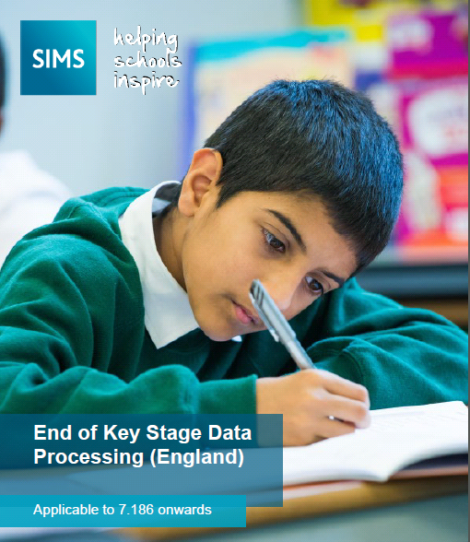
Reports
Hundreds exist already
There is a catalogue available from the documentation page
  SIMS Pre-Defined Reports Catalogue
School Report (Reports > School Report, last one)
Primary Contact Report
(Tools >Housekeeping>Primary Contact Details)
Host of reports to analyse EYFS, KS1 data and KS2 Data
https://faq.scomis.org/kb22602/
https://faq.scomis.org/wp-content/uploads/2018/11/Key-Stage-Analysis.pdf

Slide 31
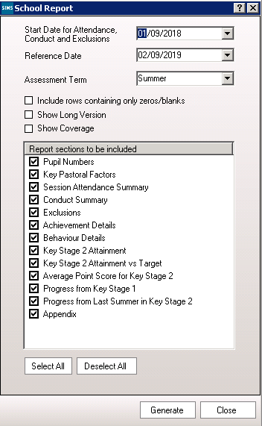
Q: Governors need to know what our Attendance figures are and how many SEN children we have?
A: Reports – School Report
You can specify what you want to include using the parameters shown opposite.
Simply ensure that your dates and term are set as required at the top, and then untick anything that you don’t currently hold in SIMS.
Notes:
When I visit schools, the majority of them show me the various excel, word or general “black magic” reports that they have created and maintained in order to provide the basic make-up of the school in Governor Reports and SLT updates. When I ask them if they have tried using the School Report, most have never heard of it, yet it has been in SIMS for many years.
The School Report covers a lot of areas in SIMS and provides the base information for a lot of requests. Simply ensure that your dates and term are set as required at the top, and then untick anything that you don’t currently hold in SIMS. Click on Generate to create your report.

Slide 32
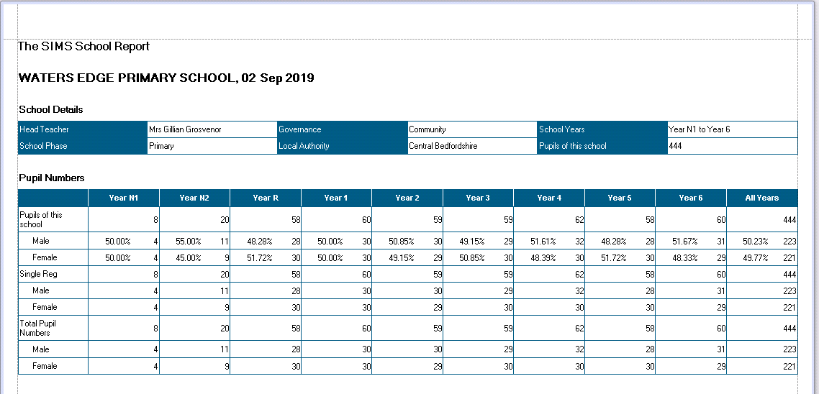
Reports – School Report
Notes:
The School Report pulls out all the information across the school and allows analysis of many areas in one report. The header identifies the Head Teacher, Phase and number of pupils on role amongst other information, and then shows the breakdown of children across the Years, together with a total. As you can see, the first page is showing us a breakdown of pupils by Year with a count and percentage breakdown by Gender in each year.

Slide 33
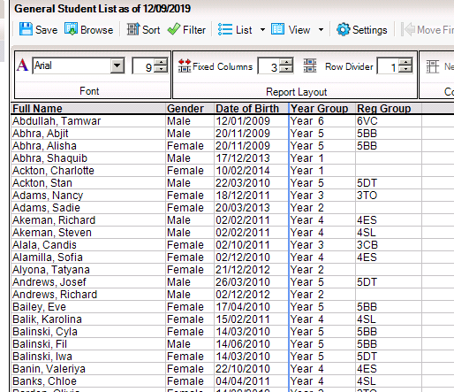
General Student List
Reports > Student List> General Student List

Slide 34
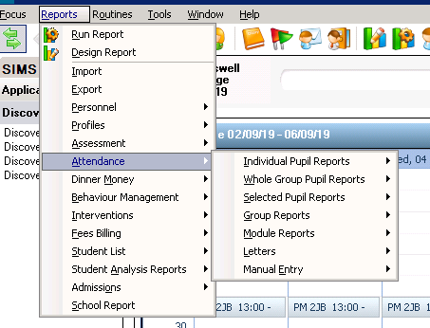
Reports – Attendance
Notes:
Attendance is a very analysed area of Schools and rightly so. Each school demonstrates safeguarding and care through it’s attendance policies and actions. Recording attendance directly into SIMS allows all the data to be cross-referenced against all the SIMS modules and gives us a lot of reports that already exist. We can produce reports by individual students, groups, specific pupils and even produce our letters. Letters sent via the Attendance module are then logged against the student, meaning that we don’t need to keep copies on an external, insecure file.

Slide 35
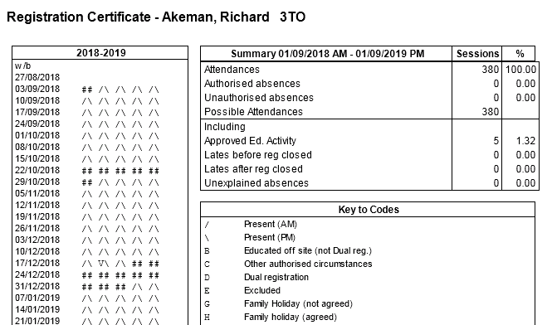
Reports – Individual Attendance
Notes:
We can produce an individual summary of attendance for a problem student, which gives all the marks entered, a key for all the codes and a overall percentage. This is very useful to print and provide to parents/guardians when discussions are needed. This can be produced directly from the Home Page attendance widgets in approximately 2 clicks.

Slide 36
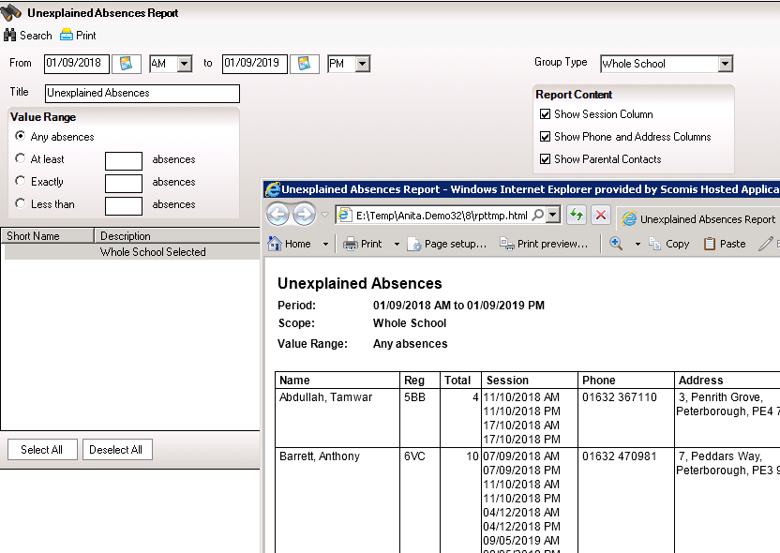
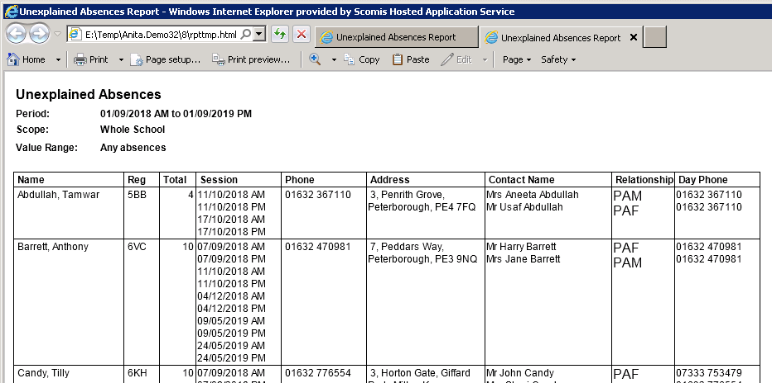
Reports – Unexplained Marks
Notes:
When it comes to finding out reasons for absence, you don’t need to go through individual classes or year groups – you can run the Unexplained Marks andif you tick the boxes to include the Phone/address and parental details, you can work through the report. It clearly shows you the dates in question, the phone numbers and the names of the carers/guardians. Changes can then be noted and entered via the Missing Marks routine.

Slide 37
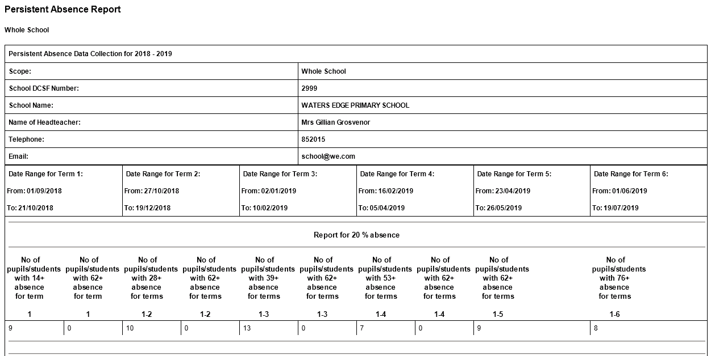
Reports – Persistent Absence
Notes:
Persistent Absence is another area that I know Attendance Officers keep spreadsheets for. This report works across the terms and gives you the figures for reporting to Governors or SLT as required. Further down the report it gives you the names and further details for you to work with and monitor.

Slide 38
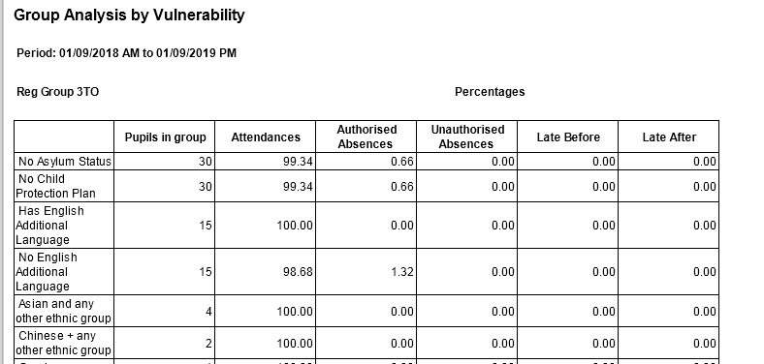
Reports – Analysis by Vulnerability
Notes:
This report takes the Attendance data and applies it against all additional need groups and those not in additional needs groups for comparison. This is a very long report and will no doubt include data you don’t require. However, it will give you the breakdown for each vulnerable group and therefore should save you a lot of time.

Slide 39
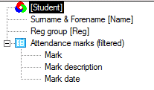
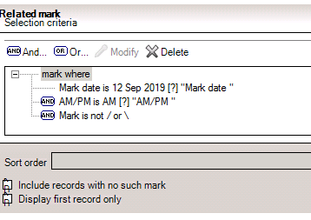
Reports – Writing your own
Reports > Design Report

Slide 40
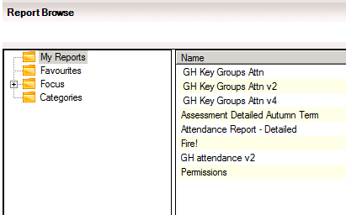
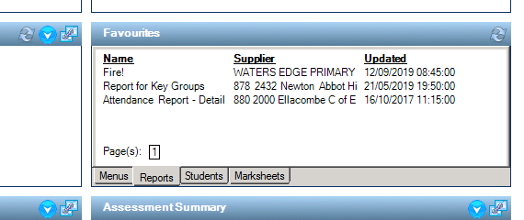
Adding reports to your favourites

Slide 41
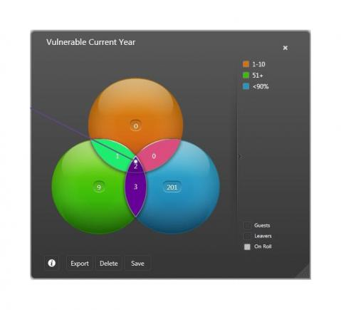
SIMS DISCOVER
A clear and complete picture of your school information
Quickly identify trends in pupil data
Track pupils and make interventions early
Question?
How long would it take you to find out:
Summer born students | Pupil Premium | FSM |
https://www.capita-sims.co.uk/products-and-services/sims-discover

Slide 42
SIMS Parent Lite
https://faq.scomis.org/kb19992/

Slide 43
GDPR
New permission group called ‘Data Protection officer’
Person Data Output (PDO) report
Routines > Data Out> Person Data Output
Routines > Student> Bulk Delete Student Data
WARNING! Scomis recommends discussion with your DPO and reference to your school’s/organisation’s ‘Data Management Policy’ before carrying out deletion of any student records.
Check:https://ico.org.uk/for-organisations/in-your-sector/education/
Refer to your legal support if any doubt!

Slide 44
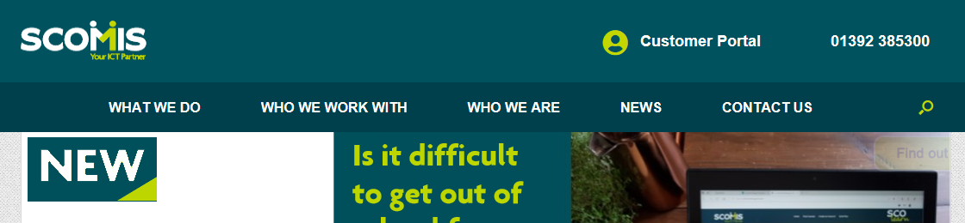
Help!!! www.scomis.org
Use your support!
Notes:
Using your support from Scomis can save you time!

Slide 45
www.scomis.org
01392 385300
scomis@devon.gov.uk

