Slide 1
Dyscalculia
What is it and how to help?

Slide 2
By the end of the session, you should:
Know what Dyscalculia is (and how to pronounce it).
Understand which aspects of Maths are affected.
Be able to identify which learners may have Dyscalculic tendencies.
Have some strategies for supporting the needs of learners with Dyscalculia.
Find support.

Slide 3

Dyscalculia
The SpLD Assessment Standards Committee Dyscalculia Definition:
Dyscalculia is a specific and persistent difficulty in understanding numbers which can lead to a diverse range of difficulties with mathematics. It will be unexpected in relation to age, level of education and experience and occurs across all ages and abilities. Mathematics difficulties are best thought of as a continuum, not a distinct category, and they have many causal factors.
Dyscalculia shows difficulties with number sense, including subitising, symbolic and non-symbolic magnitude comparison, and ordering. It can occur singly but often co-occurs with other specific learning difficulties, mathematics anxiety and medical conditions. (SASC, 2020)

Slide 4
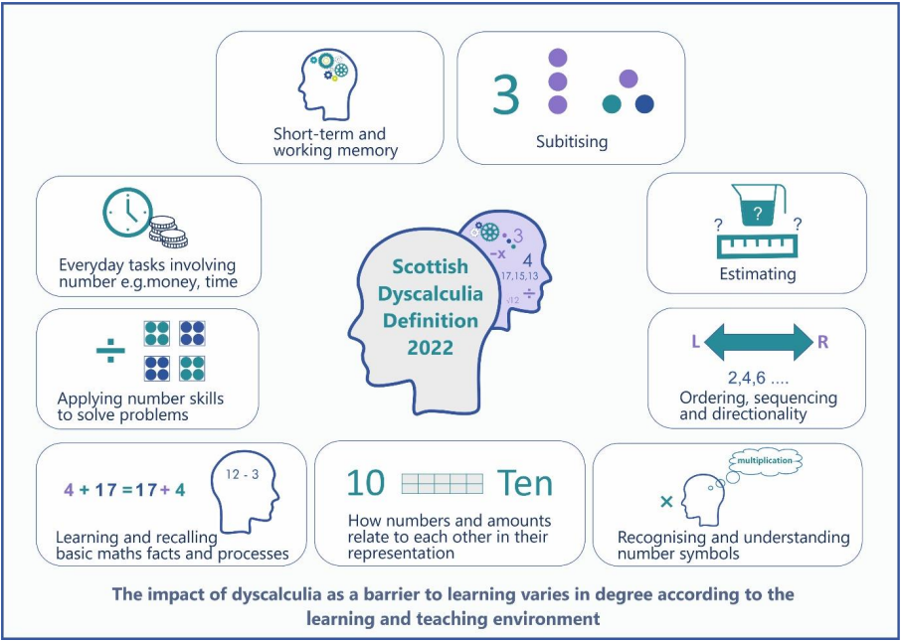

Slide 5
Context
Approximately, 6% of the British population suffer from Dyscalculia and approximately 24% of the population have problems with maths. (O.E.C.D – Organisation for Economic Co-Operation and Development, Skills for Life Study - 2013)
You are 100 more times more likely to be diagnosed and given teaching support with Dyslexia than those with Dyscalculia. (Morsanyi, Van Beers, McCormack & McGourty – 2018)

Slide 6
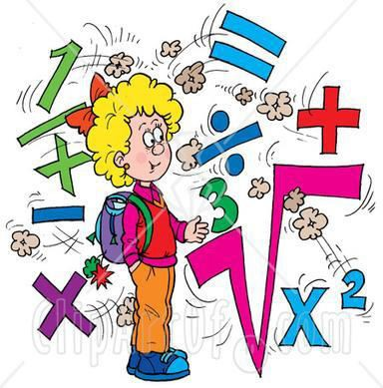
Causes of Dyscalculia and Numeracy Difficulties
Dyscalculia is a deficit in the core capacity to process numbers. Developmental dyscalculia is present at birth. Acquired Dyscalculia is caused by brain injury.
Number difficulties may also arise from specific learning difficulties such as dyslexia, dyspraxia, ADHD and ASD.
Other factors may contribute:
  Visual perceptual difficulties
  Working memory difficulties
Poor memory of sequencing skills
Developmental delay
Lack of knowledge of maths language
Maths anxiety.

Slide 7
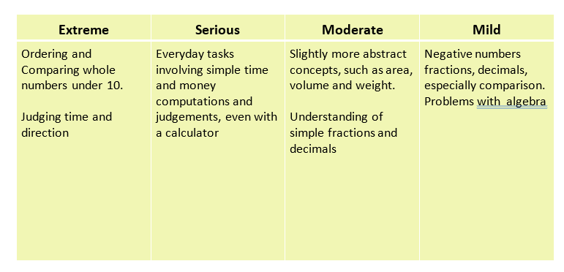
Dyscalculia Spectrum

Slide 8
Why is maths hard for some children?
Maths is…
Abstract in the sense that children may not relate the symbols to quantity, e.g., knowing that 5 is one more than 4 not just the number that comes after 4.
A building block subject where one fact leads to another. If earlier concepts are not fully understood, the pupil will not be able to make sense of more advanced concepts.
Complex, with many ways of representing equivalents e.g., involves concepts of time, quantity, space and language.

Slide 9
Key Indicator – Number Sense
What is number sense?
… a person’s ability to understand, relate and connect numbers. People with strong number sense can think flexibly and fluently about numbers.
Subitising
This is the ability to identify a number of objects without counting them. This normally develops from an early age.

Slide 10
How many?

Slide 13
It is easier to subitise if objects are arranged in patterns, such as dice patterns.
These dice patterns are key for
helping dyscalculic learners as it
helps them to visualise numbers and
understand key concepts of number.

Slide 14
Key Indicator - Estimating
To make a sensible guess about how many things there are.

Slide 15
Key Indicator - Counting
To verify how accurate your estimate is and to note how the counting is done.
Tend to see each number as a pile of ones (not understanding the ‘two-ness of two’).
Tend to view every mathematical operation as an instruction to count and facts never become automatic – the counting gap.
Unaware that numbers contain other numbers e.g., 4 can mean 4 but also can be ‘seen’ as 2 and 2 and 3 and 1.
Unable to relate previous learning or recent calculation so see each problem as a new one.

Slide 16
Key Indicator - Sequencing
Sequencing refers to our ability to perceive items in a specific order and to remember that sequence.
Orally
- What number comes immediately before 60?
Written
- What number comes immediately after 199?

Slide 17
Ways to help…
Find a connection. Give the learner a card with the number three on and get them to jump 3 times etc.
Rounding numbers to encourage estimation 387 x 43 to been seen as 400 x 40
Use base ten materials to support place value
Count forwards and backwards from different starting points
Verbalise everything

Slide 18
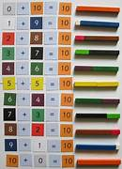
Reading and Recording Numbers
The symbols 0 to 9 are combined in various ways to form all possible numbers.
Pupils should work with concrete materials to build visual images. They need to draw their own diagrams to enhance the visualisation process.
Writing numbers is harder than reading numbers.
1
2
3
4
5
6
7
8
9

Slide 19
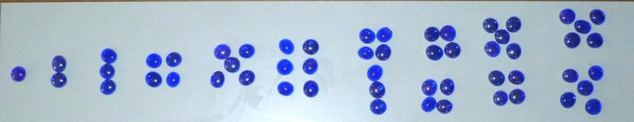
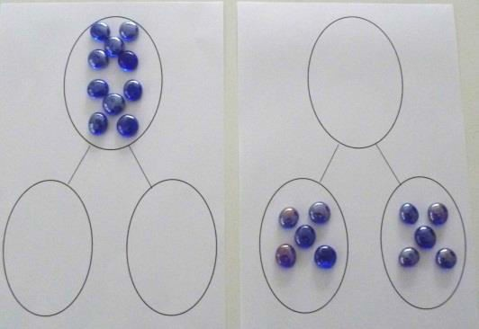

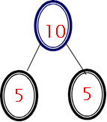


Dot Patterns and Part-Whole Model
Discover patterns
Use for teaching calculation
e.g., more than, less than,; reasoning from key facts to calculate.
Key Number Bonds
10 = 5 + 5
5 + 5 = 10
10 – 5 = 5
Handle it See it Draw it Write it

Slide 20
Reasoning
Link to everyday situations.
Represent a concept with diagrams e.g., 4 x 3 such as an array.
Role play

Slide 21
Word Problems
How to help
Start with familiar ‘fun’ topics
Use small numbers (initially)
Verbalise the problem and encourage diagrams to reflect it
Use highlighters to identify key terms and parts of the question
Use concrete materials to show relationship
Simple language
For example
Bob has 3 sweets. Sam also has some sweets. Sam and Bob have 9 sweets altogether. How many sweets does Sam have?
Much better as…There are 9 sweets. 3 of them belong to Bob. The rest belong to Sam. How many sweets does Sam have?

Slide 22
Characteristics of students with poor memory
May be well-adjusted socially but…
Make poor academic progress even after literacy and numeracy interventions.
Fail to progress in building vocabulary knowledge and find mental maths extremely difficult.
Reserved in group activities: rarely volunteering answers and sometimes not answering direct questions.
Behave as though they have not paid attention. e.g., forgetting part or all of instructions or messages, or not seeing tasks through to completion.
Frequently lose their place, leave out crucial details, repeat info, make many errors.
Are considered to have short attention spans and also to be easily distracted. Often mis-labelled as having ADHD.

Slide 23
Memory
Remembering or retrieving facts – use flow charts
Understanding terminology – use repetition
Understanding word problems – use visuals and manipulatives
Performing mental calculations – use diagrams/tables
Carrying out and remembering procedures – memory cards
Keeping track of problems solving – use visuals

Slide 24
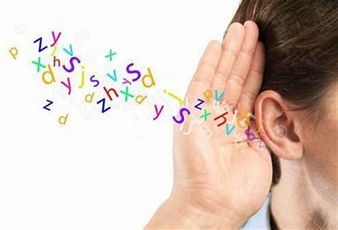
Memory
If there are memory problems the following may be difficult:
Copying from the board (especially if you are still talking to them)
Having the correct equipment
Remembering facts/formulae
Remembering instructions/messages
Making notes/ taking dictation
Times tables
Messy word environment

Slide 25
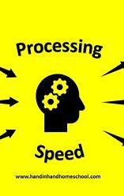
Processing Speed
Retrieving information at speed – times tables, mental arithmetic.
Labelling – shape
Word finding – not being able to find the right word at the right time.
Following instructions at the beginning of a lesson, reading a multi-step word problem.
Completing work in a time limit
Tests!

Slide 26
Times tables
Online programmes such as Hit the Button or TT Rockstars involve recalling the tables at speed.
If a child has processing difficulties, this will be very difficult for them and will damage self-esteem.
Instead…

Slide 27
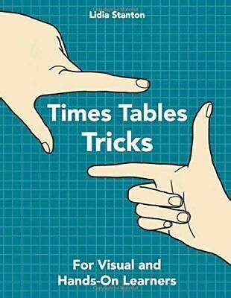
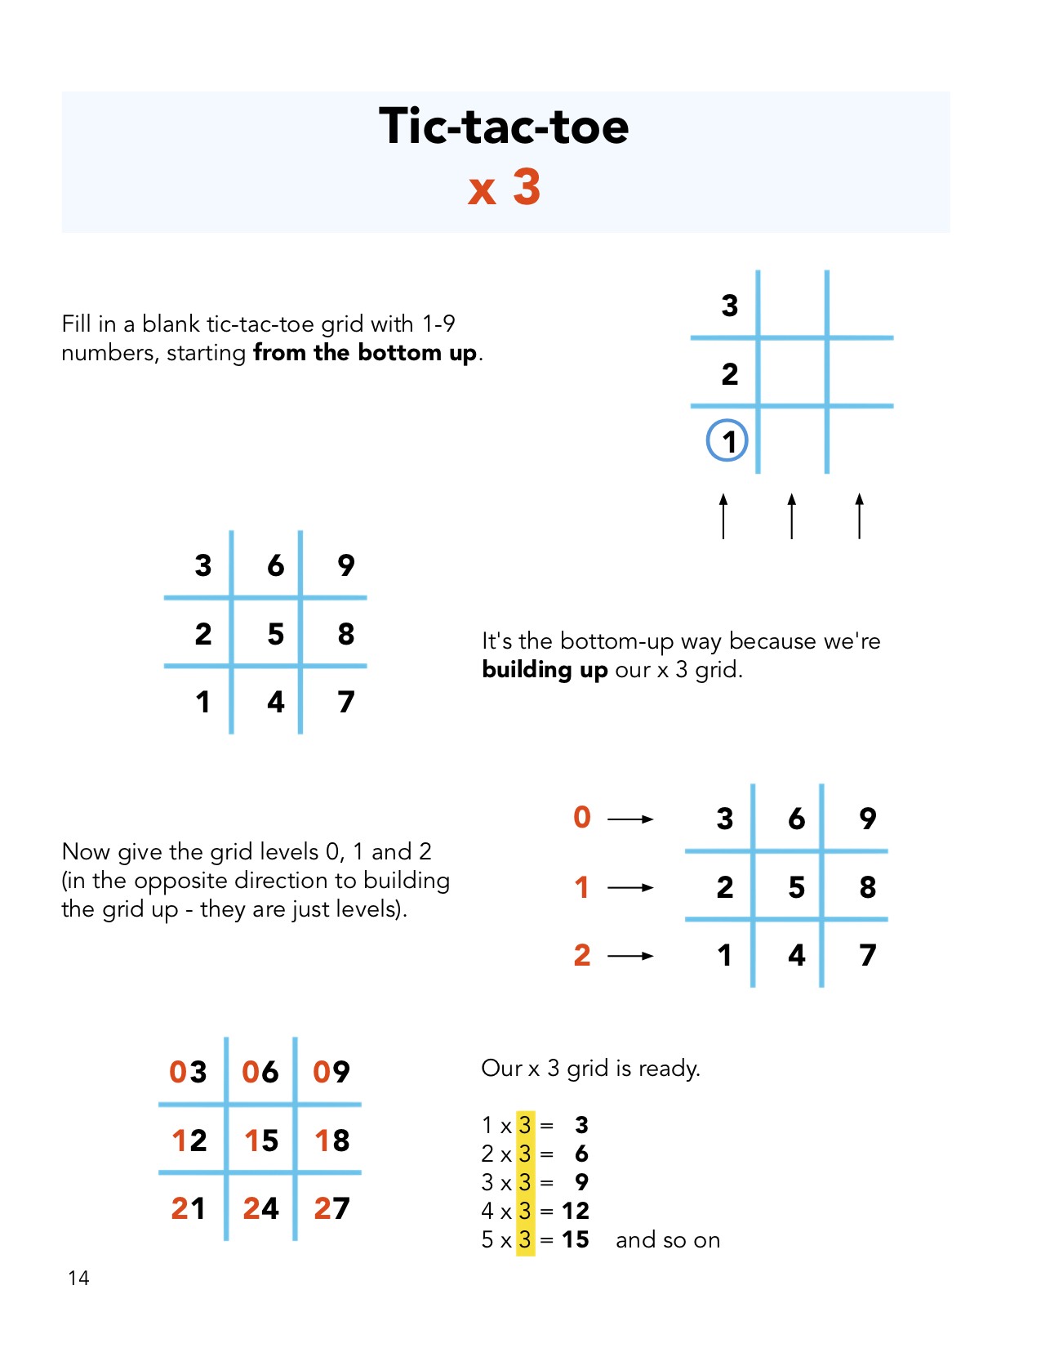
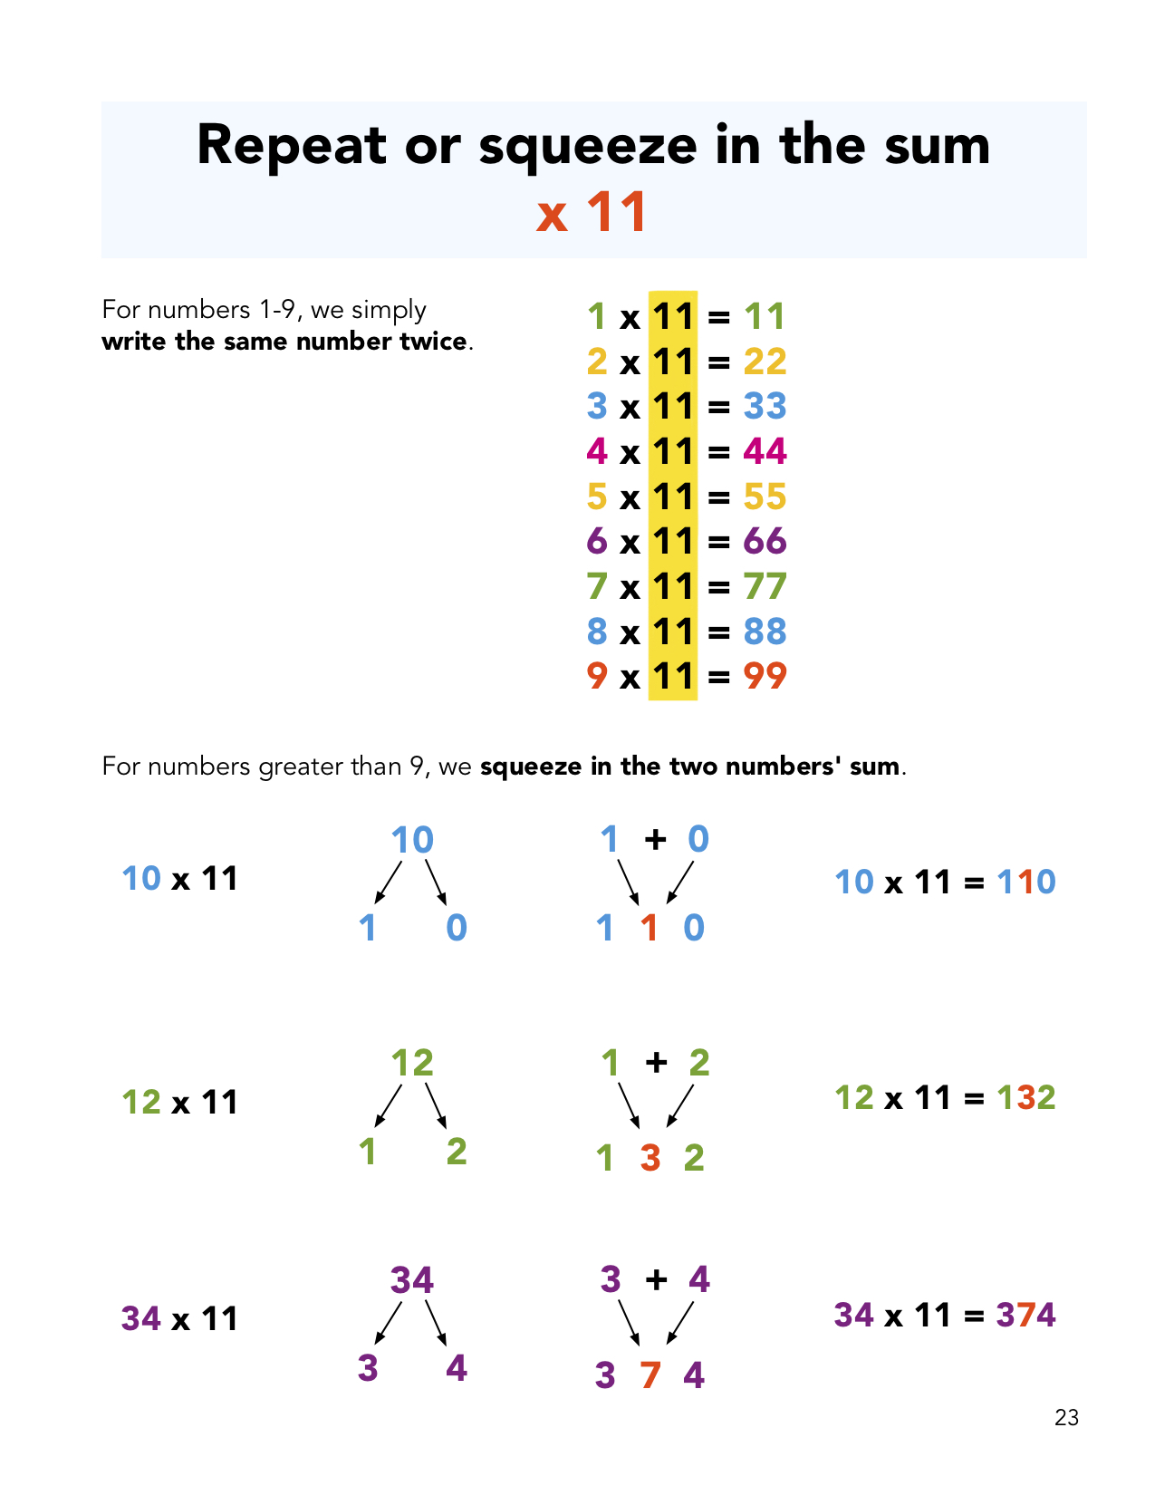
Try Lidia Stanton’s way…
Lidia Stanton Books | Times Tables Tricks: For Visual and Hands-On Learners

Slide 28
Read the instructions and then copy the text

Slide 29
Pick up some paper and a pen or pencil.
If the paper has lines, turn it around so it is landscape.
If the paper has no lines, turn it so it is portrait.
Pick up a pen or pencil in the hand that you don’t normally write with.
If you are writing with a black pen, stand up.
If you are using a pencil, push your sleeves up.

Slide 30
You are going to see a short text and you will have 3 minutes to copy it down.
BUT whenever you want to write an ‘e’ write a cross instead, like this +.
Instead of an ‘a’ please write a question mark ?.
And instead of an ‘i’ please write an equal sign =

Slide 31
Some people are light or colour sensitive.
Bright sunlight or fluorescent lights may bother them. Back print on shiny white paper may be uncomfortable and whiteboards may be too shiny. Pattern glare may also be a problem. It may be helpful to have:
Coloured paper for writing
Coloured overlays for reading
Tinted lenses in glasses for both reading and writing.
The colours and brightness on computer screens can be adjusted to suit individuals.

Slide 32

Emotional and Behavioural problems – also co-morbid but can lead to:
Low self esteem – resulting from weak numeracy skills and repeatedly struggling
Frustration
May find it difficult to get started
Avoidance strategies
Exhaustion
Poor concentration
Nervous anxiety – parent and/or staff expectation can be overwhelming
Shy/introverted
Aggressive

Slide 33
Signs of visual difficulties:
Rubbing eyes
Head very close to paper
Head on one side
Hand over one eye
Pulling hair over one eye
Headaches
Complaining of the words blurring or moving

Slide 34
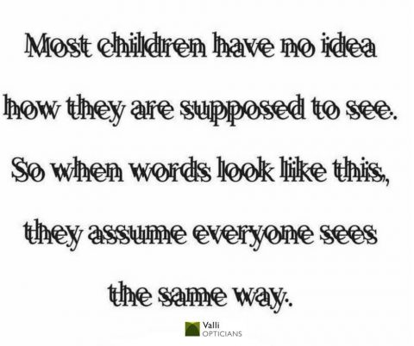
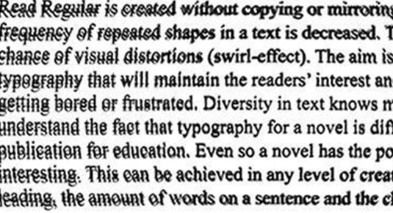
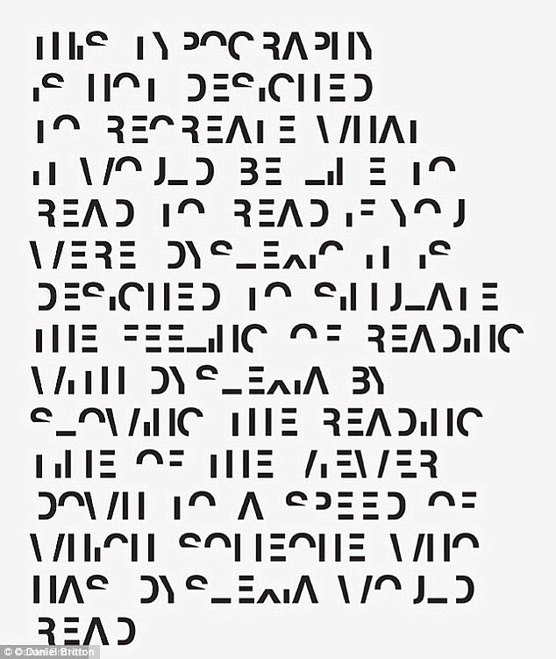

Slide 35
Maths Anxiety
Physical symptoms Psychological Symptoms
Butterflies in stomach Negative self-talk
Sweaty hands Panic or fear
Increased heartbeat Being overly worried
Tension in muscles Fight or flight
Clenched fists Feeling helpless
Breathing quickly
Headaches

Slide 36

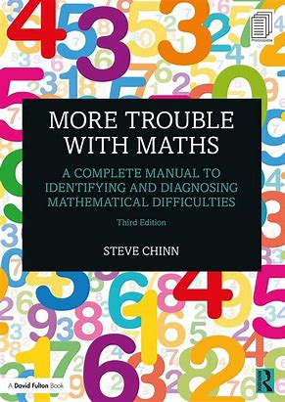
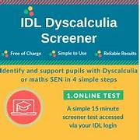
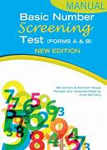

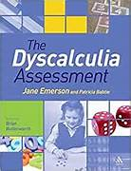
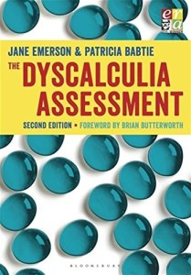
Maths Assessment Screeners
There are a number of maths screeners in the marketplace for example:
Basic Number Screening Test
Dynamo maths
Developmental Dyscalculia Assessment
IDL Dyscalculia Screener
GL Dyscalculia Screener
More Trouble with Maths Test – 15-minute Test
The Dyscalculia Assessment
In order to diagnose Dyscalculia, these tests are NOT sufficient on their own!

Slide 37
How to help?
Carry out a maths assessment to show areas of difficulty;
Do an error analysis;
Teach just before the starting point;
Make sure the basics are secure;
DON’T GET THEM TO COPY FROM THE BOARD - give them a close copy. .
Limit the amount of instructions/tasks they are given.
Make teaching and learning multi-sensory (visual, kinaesthetic, auditory)

Slide 38
Error Analysis
Teaching to follow the assessment (error analysis)
What do the following errors mean?
6 + 5 = 10
3.7 x 10 = 3.70
83
+47
1210

Slide 39
A Successful Intervention Programme
Work in small chunks
Give more oral work than written work, especially at the start
Carefully limit all memory demands
Make it personal
Revise and repeat
Be realistic in target setting
Vary the teaching modes (multi-sensory)
Make maths fun!
Mistakes are good

Slide 40
Teaching Numeracy – Key Concepts
1. Handle it (concrete)
2 See it
3 Draw it (diagrammatic/pictorial
4 Talk it
5 Write (abstract)
6 Teach it
Teaching all too often starts and stays at number 5 (which is usually the assessed area)

Slide 41
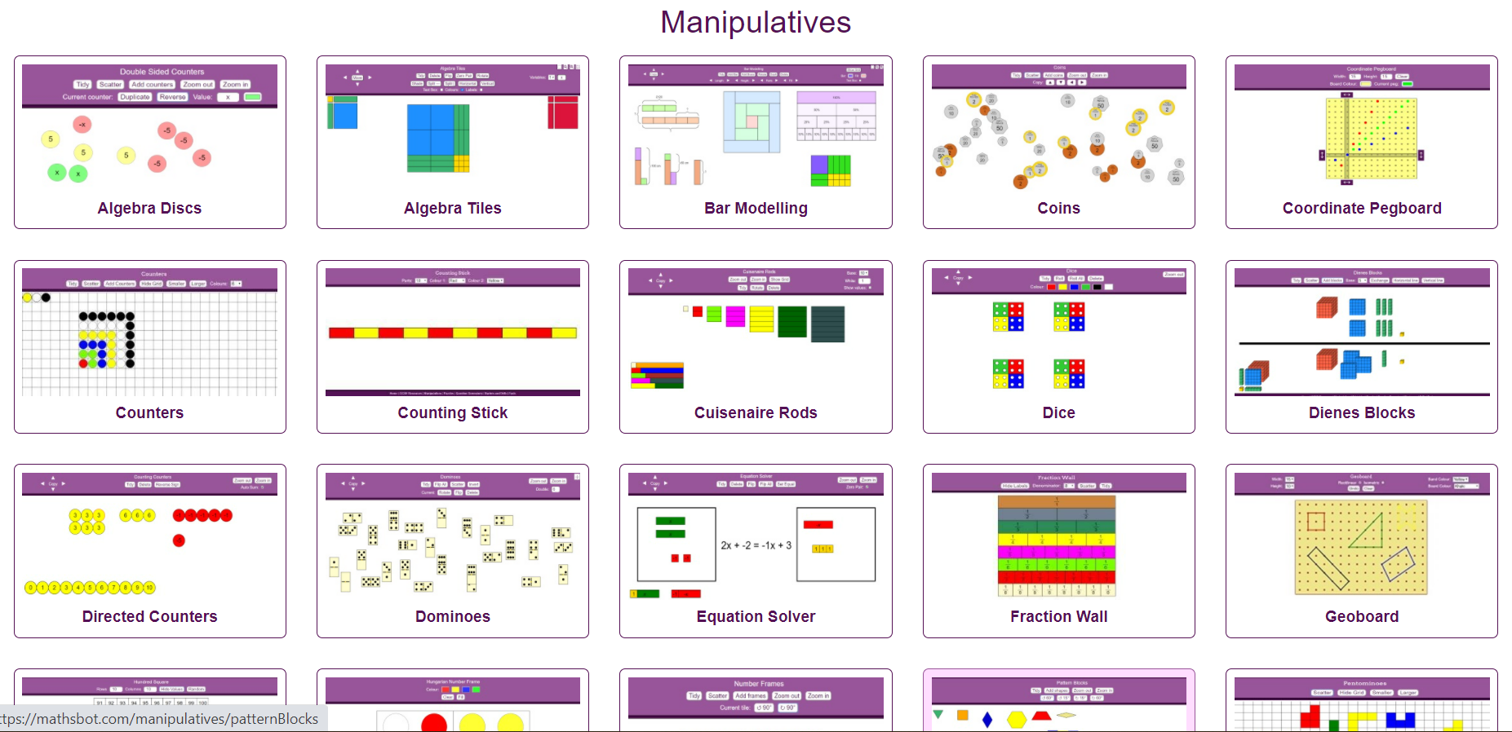
Manipulativeswww.mathsbot.com

Slide 42
Maths Explained - Maths Explained — Steve Chinn
Our Maths lessons - Maths Explained video tutorials
Steve Chinn’s Maths Explained website has some fantastic tutorial videos that the student can watch and worksheets to then embed the learning further.

Slide 43
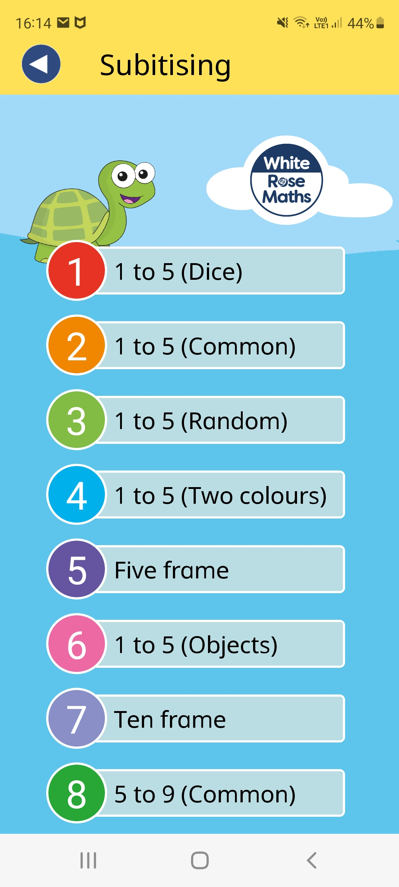
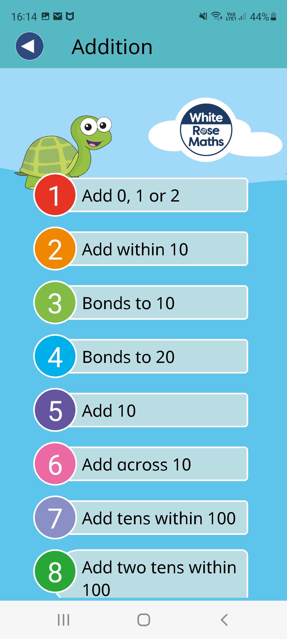
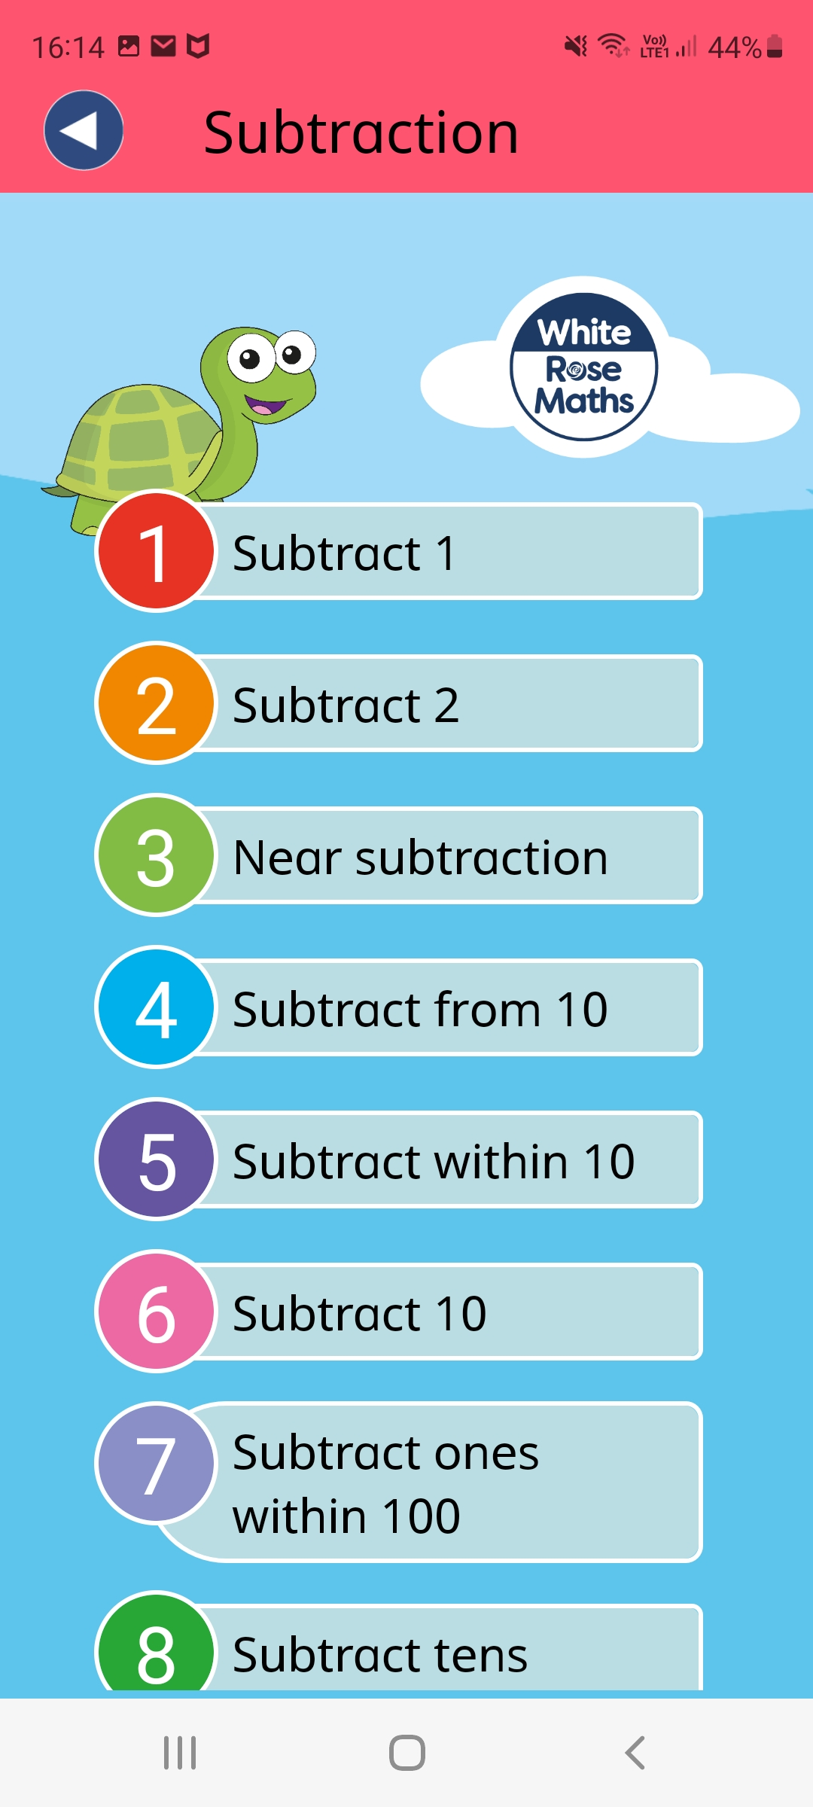
The White Rose 1 minute Maths App (downloaded from the
App Store or Playstore deals with subitising, addition and subtraction.
1-Minute Maths App | White Rose Maths

Slide 44
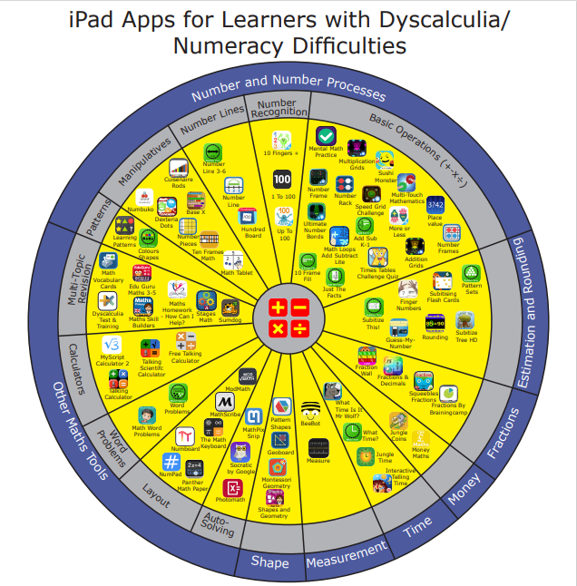
Number Sense Maths
Systematic number fact teaching | Number Sense Maths
Early Number Sense - I See Maths
Maths Explained video tutorials
Dyscalculia Questionnaire

Slide 45
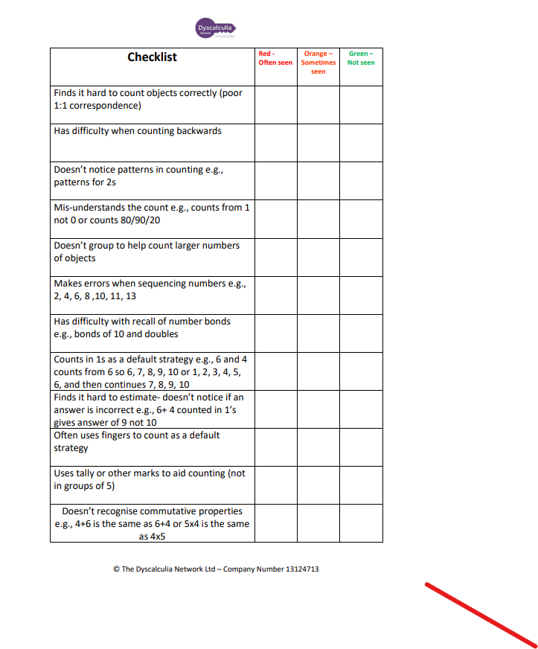
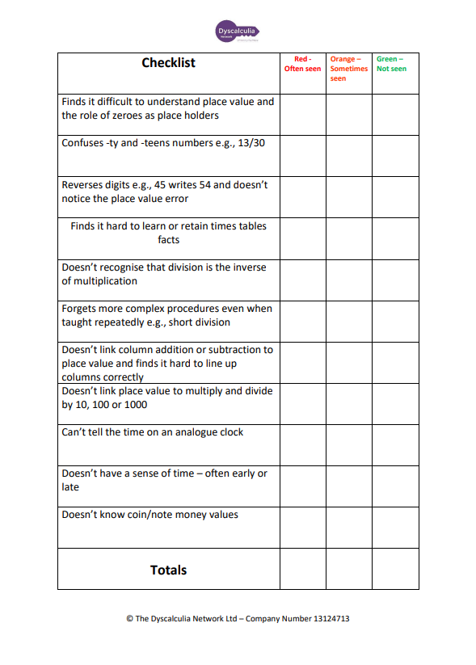

Slide 46




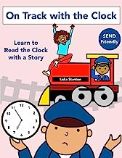
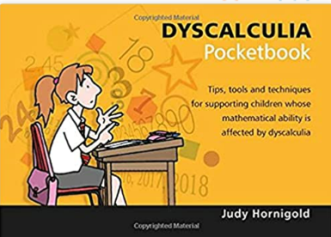
Websites and Publications
Dyscalculia Network - About Dyscalculia (dyscalculianetwork.com)
The Dyscalculia Association - Understanding Maths Difficulties. Training and Diagnosis.
Maths Explained – www.mathsexplained.co.uk
www.dynamomaths.co.uk
More trouble with Maths – Steve Chinn
Anything by Jane Emerson

Slide 47
Thank you for having me.
Any questions?

