Slide 1
Primary SEND Professional Community 22nd June 2023 Universal SEND Services Programme 2022-2025
Notes:
Use for slides referring to the USS programme

Slide 2
Live webinar
Notes:
Use for slides referring to the USS programme

Slide 3
Preparation for Adulthood from the Earliest Years
‘Preparing for Adulthood from the Earliest Years’ Review Guide was trialled with schools in Oxfordshire who found that taking part in the process resulted in:
A clear focus and drive for school improvement
More widely shared expertise and good practice
Better understanding of the rationale of PfAEY
A clear and strategic vision for embedding PfAEY
A named PfAEY governor.
How a Preparation for Adulthood Review helped us- Becky Jones | Whole School SEND
Notes:
Use for slides referring to the USS programmeAs part of the Universal SEND Services programme, we will be recruiting 80 nursery, primary, secondary and school sixth form settings to carry out a review in the Autumn term of 2023. Settings will receive training and support to carry out the review, and will be encouraged to produce an analysis report and action plan. Participating schools will also have an opportunity to cascade PfAEY training and support to a partner school the following year

Slide 4
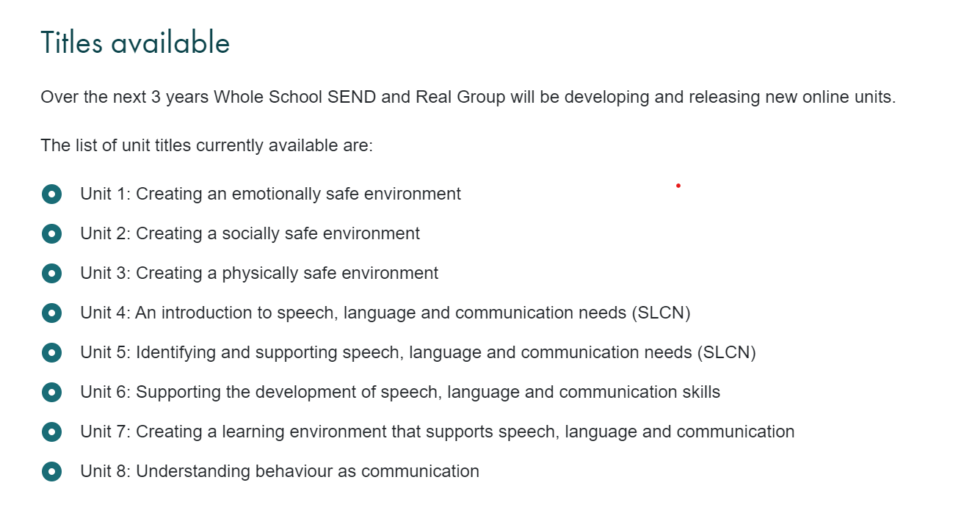
Online CPD modules to date
Notes:
Use for slides referring to the USS programme

Slide 5
YST Lead Inclusion Schools
53 schools across the country
Working locally with schools, teachers, School Games Organisers
Focusing on:
Training, advice, guidance
Influencing and supporting more inclusive School Games
Developing Inclusive Youth Leadership pathway
Test, challenge, disseminate solutions for wider network through innovation
To find out more about Inclusion Lead Schools please contact: Rebecca Tyers Project Officer - Inclusion & Diversity rebecca.tyers@youthsporttrust.org
#YSTLeadSchools

Slide 6
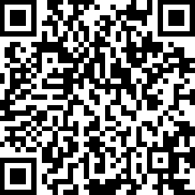
Stay in touch
info@wholeschoolsend.co.uk
Regional SEND Leader Southwest
Alison Betts
RSL.SW@wholeschoolsend.com
Deputy Regional SEND Leader Southwest
Emma Vyvyan DRSL2.SW@wholeschoolsend.com
Deputy Regional SEND Leader Southwest
Sam Battershall DRSL3.SW@wholeschoolsend.com
Find out more and join our member community
Whole School SEND
@WholeSchoolSEND
www.wholeschoolsend.org.uk
Whole School SEND

